Slide 1
Time Series in R
Practical Data Science Meetup
By Mark Nielsen

Slide 2
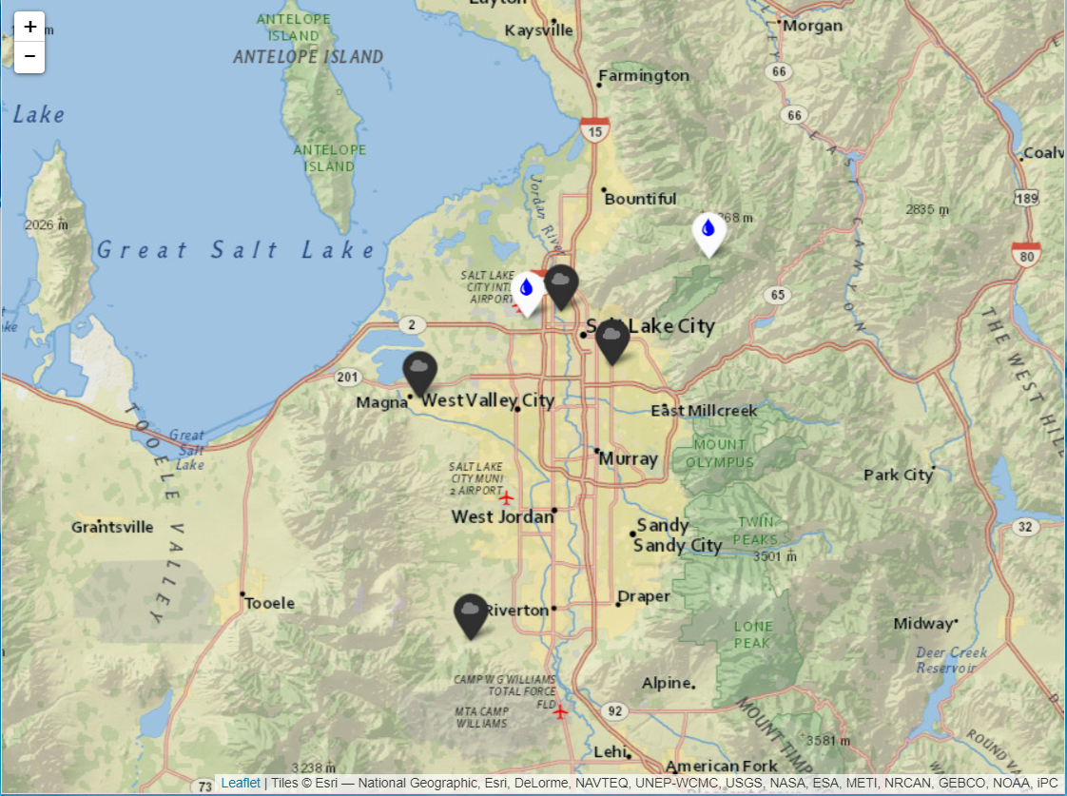
Air Quality and Weather Data
Daily PM 2.5
Inversion (Valley - Peak Temperature)
Wind Speed
Precipitation
Firework Holidays

Slide 3
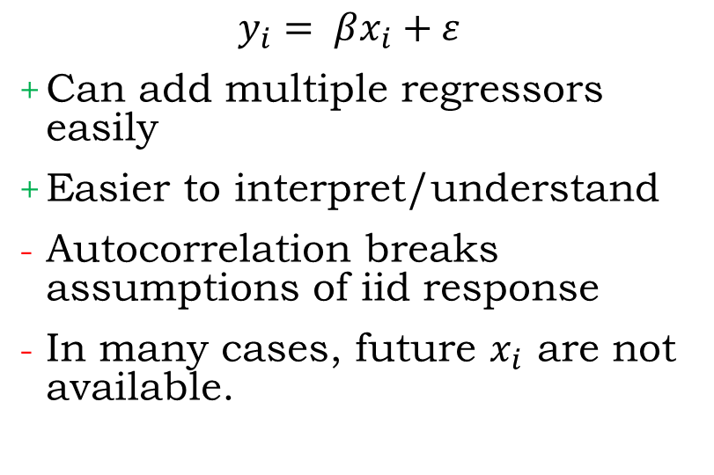
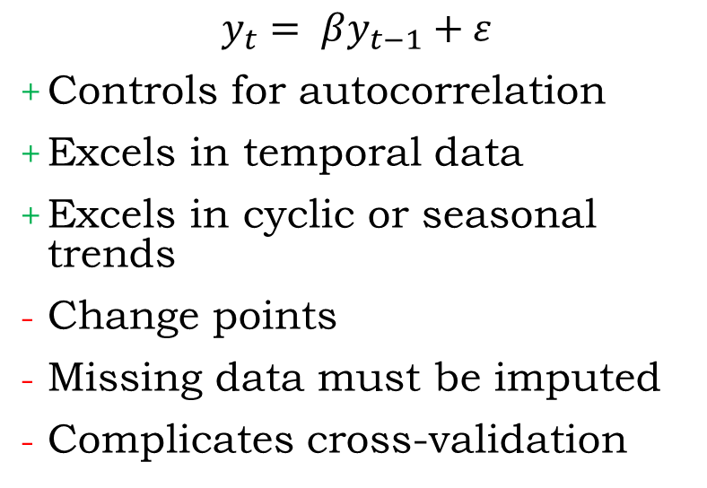
Time Series vs. Linear Regression
Time Series
Linear Regression
$$y_{t}= βy_{t−1}+ε$$
Controls for autocorrelation
Excels in temporal data
Excels in cyclic or seasonal trends
Change points
Missing data must be imputed
Complicates cross-validation
$$y_{i}= βx_{i}+ε$$
Can add multiple regressors easily
Easier to interpret/understand
Autocorrelation breaks assumptions of iid response
In many cases, future $x_{i}$ are not available.

Slide 4
Modeling Demo in R

Slide 5
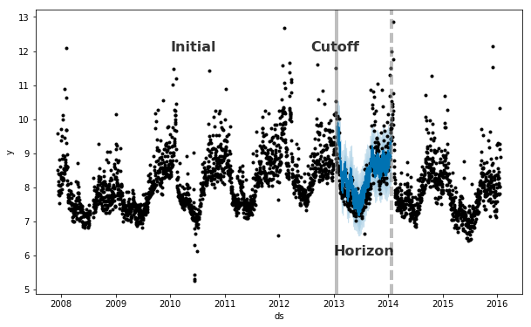
Time-Series Cross-Validation
Photo Credit: Prophet Online Docs https://facebook.github.io/prophet/docs/diagnostics.html

Slide 6
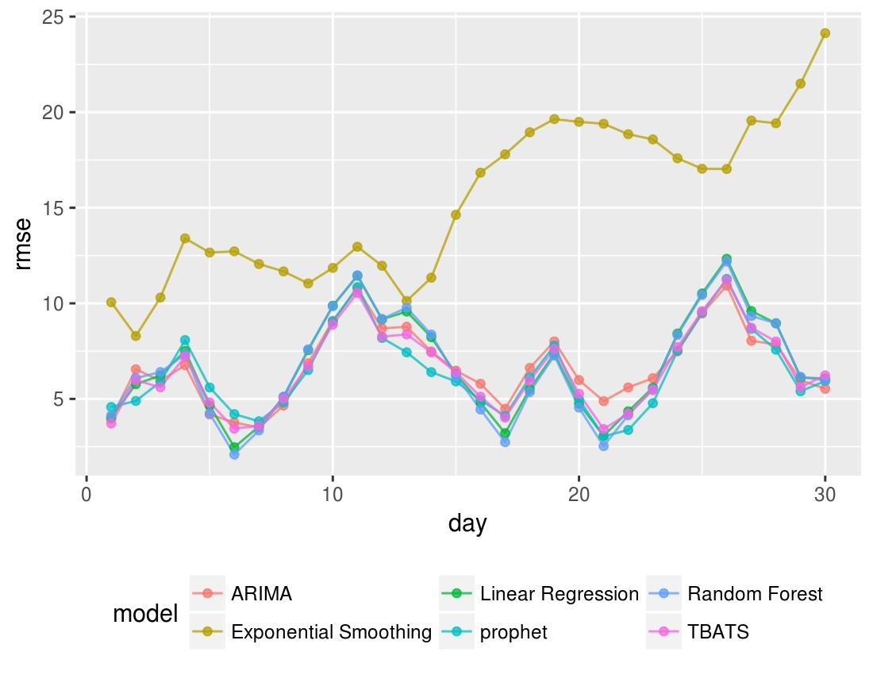
RMSE for the Horizon
ETS doesn’t do so well since it is only considering weekly seasonality.
Linear Regression, Random Forest, TBATS, ARIMA and Prophet all perform similarly.

Slide 7
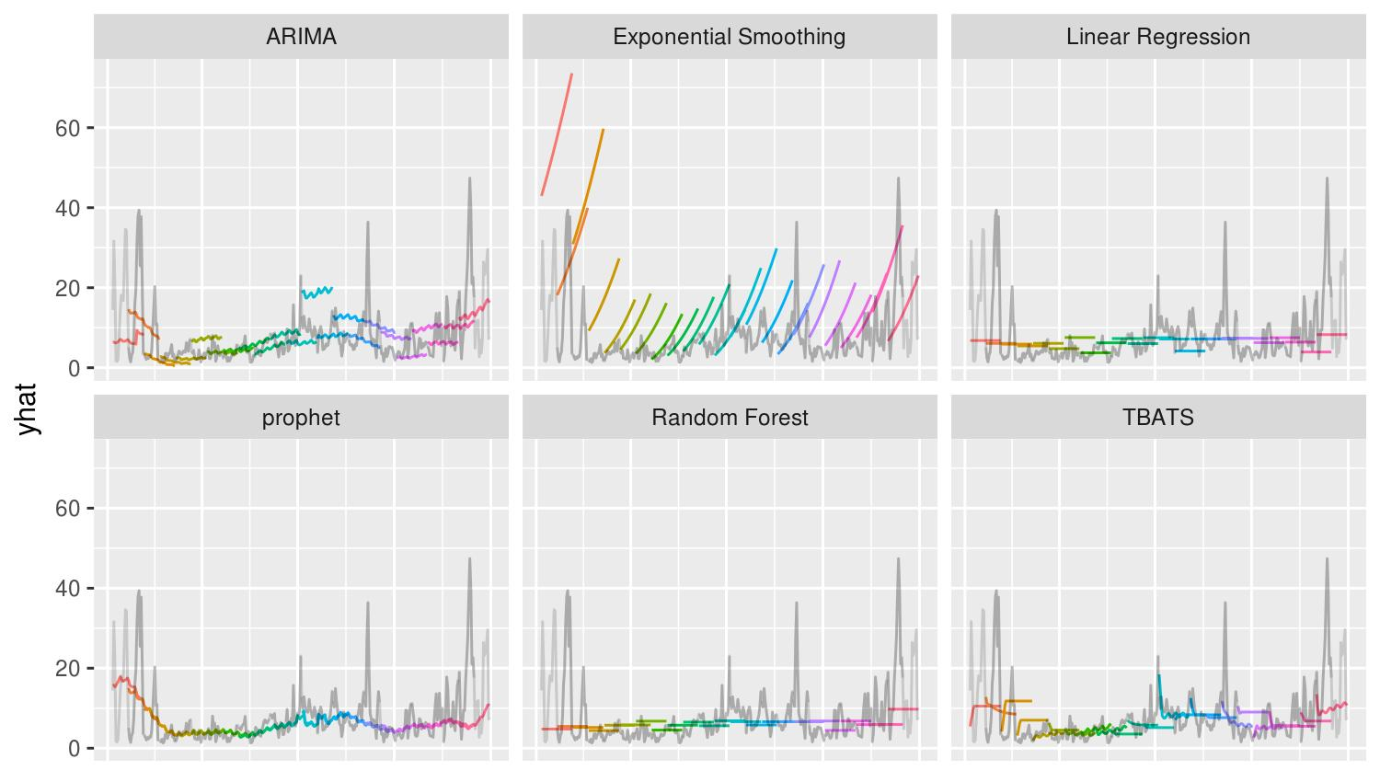

Slide 8
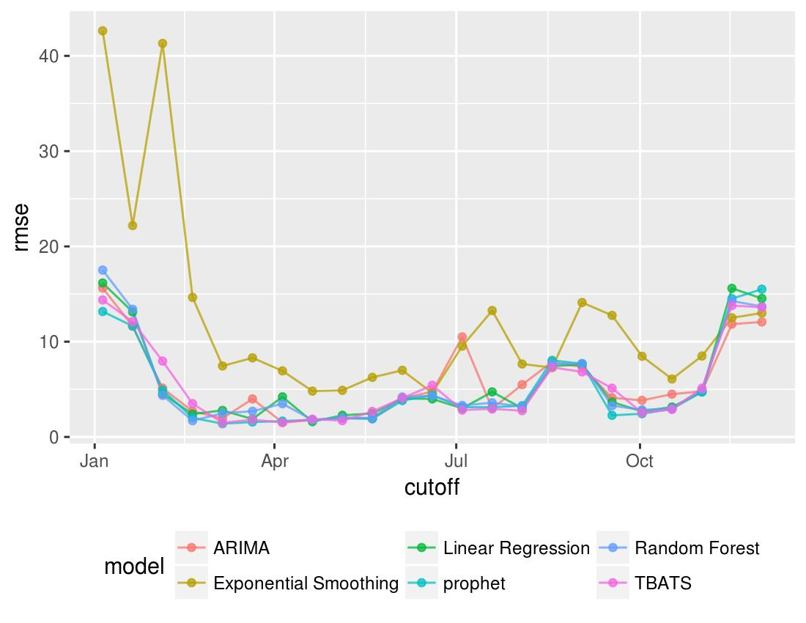
RMSE for the Cutoff Date
Notice that all models don’t do well in months with high PM2.5.
September 2017 was particularly difficult for all models. Any guesses why?
Notes:
See a bump in the high PM2.5 months.
I was seeing one the beginning of July, but once adjusting for Fireworks id dropped down.

Slide 9
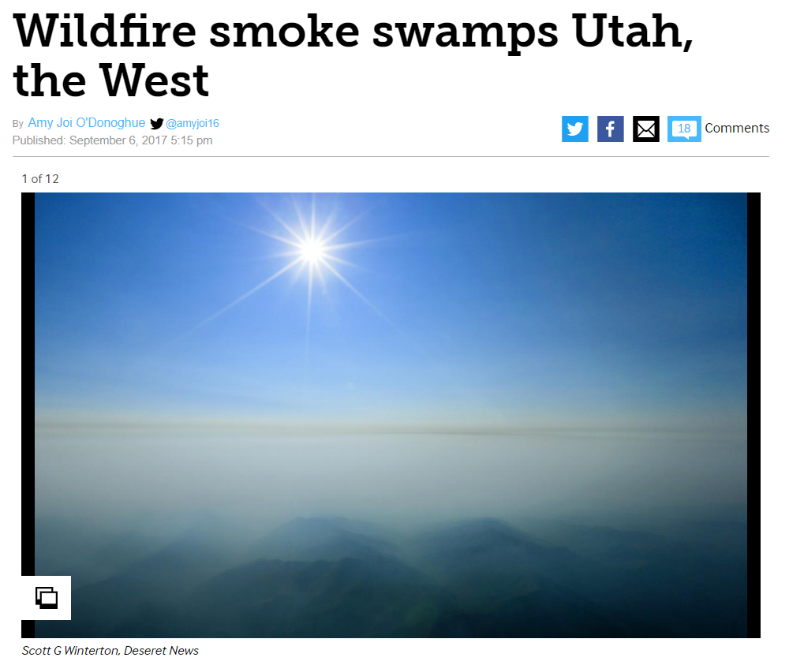

Slide 10
Where to start?
FutureLearn Forecasting MOOC:
https://www.futurelearn.com/courses/business-analytics-forecasting
Forecasting: Principles and Practice:
http://otexts.org/fpp/
Prophet: Forecasting at Scale:
https://facebook.github.io/prophet/

Slide 11
References
Hyndman, R.J. and Athanasopoulos, G. (2013) Forecasting: principles and practice. OTexts: Melbourne, Australia. http://otexts.org/fpp/. Accessed on February 11, 2018.
National Center for Environmental Information. Climate Data Online available at https://www.ncdc.noaa.gov/cdo-web. Accessed February 11, 2018.
Sean Taylor and Ben Letham (2017). prophet: Automatic Forecasting Procedure. R package version 0.2.1.9000. https://facebook.github.io/prophet/.
US Environmental Protection Agency. Air Quality System Data Mart [internet database] available at http://www.epa.gov/ttn/airs/aqsdatamart. Accessed February 11, 2018.

Slide 12
Questions?

